Slide 1
AI RESUME BUILDER
NAME : V. PERIYASAMY
REGISTER NUMBER : 25024U09028
NAAN MUDHALVAN ID : astvu25025024u09028
DEPARTMENT : BCA
COLLEGE NAME : SKP ARTS AND SCIENCE COLLEGE
UNIVERSITY NAME : THIRUVALLUVAR UNIVERSITY

Slide 2
AGENDA
01. PROJECT TITLE
08. MODULES AND DESCRIPTION
02. PROBLEM STATEMENT
09. FEATURES AND FUNCTIONALITY
03. PROJECT OVERVIEW
10. ADVANTAGES OF THE PROJECT
04. SCOPE OF THE PROJECT
05. END USERS
11. RESULTS AND SCREENSHOTS
06.TOOLS AND TECHNOLOGY
12. CONCLUSION
07. SYSTEM DESIGN AND LAYOUT
13. GITHUB LINK

Slide 3
01. PROJECT TITLE
AI RESUME BUILDER
AI Resume Builder is a Professional Resume Builder using Frontend Development ( HTML, CSS, JavaScript ).

Slide 4
02. PROBLEM STATEMENT
Resume preparation is time – consuming and often inconsistent.
Students and Freshers face difficulties in designing professional resumes.
Manual formatting leads to errors and lack of standardization.
Need for a fast, user-friendly, and professional tool to create resumes.

Slide 5
03. PROJECT OVERVIEW:
A Web- based resume builder Application.
Provides a form for input(Name, Skills, Education, Certificates, Projects).
Shows a live preview of resume while typing.
Supports profile picture upload, multiple projects, and certifications.
Resume can be downloaded as PDF instantly.

Slide 6
04. SCOPE OF THE PROJECT:
Easy and Professional Resume creations- users can quickly build resumes with modern.
Live Preview and customization – Real time Preview of Education, Skills, Projects, and Achievements, Certifications.
Instant Pdf Export.
Future Scalability can be enhanced with Ai Suggestions.

Slide 7
05. END USERS
Preparing Resumes for internships and campus placements.
Students
Fresh Graduates
Working Professionals
Fresh Graduates applying for their first job.
Who need quick and neat resumes.

Slide 8
06. TOOLS AND TECHNOLOGIES
CSS
JavaScript
HTML

Slide 9
07. SYSTEM DESIGN AND LAYOUT
Left Side :
Input form for personal details, like education, Skills, Achievements, Projects, etc.
Responsive Design :
Works on Desktop and Mobile.
Dark / Light :
Themes mode available.

Slide 10
08. MODULES AND DESCRIPTION
Input Form Module :
– Takes user details.
2. Live Preview Module :
– Updates resume instantly.
3. Dynamic Lists Module :
– Projects, Certifications, References.
4. Theme Module :
– Dark/Light toggle.
5. PDF Export Module :
– Generates professional resume in PDF.

Slide 11
09. FEATURES AND FUNCTIONALITY
Upload profile picture.
Enter education, skills, languages, projects, certifications.
Add references, achievements, and hobbies.
Live resume preview while typing.
Theme toggle (Dark/Light).
One-click Download PDF option.
Clear all inputs button.

Slide 12
10. ADVANTAGES OF THE PROJECT
Saves time in resume preparation.
Provides a Professional look without effort.
Works Offline ( no internet or server required ).
Easy to use interface for all users.

Slide 13
11. DISADVANTAGES OF THE PROJECT
Limited Templates
No Storage Data
Basic Functionality
Single Language Support
Dependent on Mobile & Browser

Slide 14
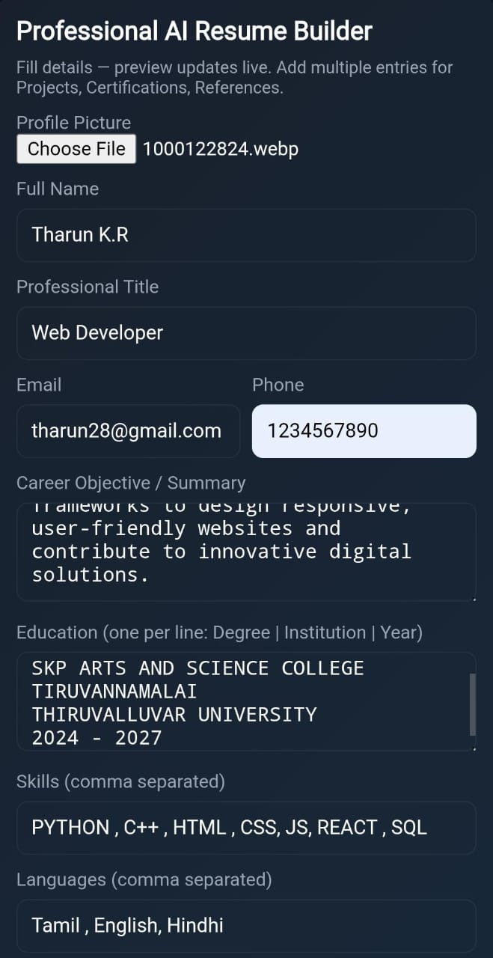
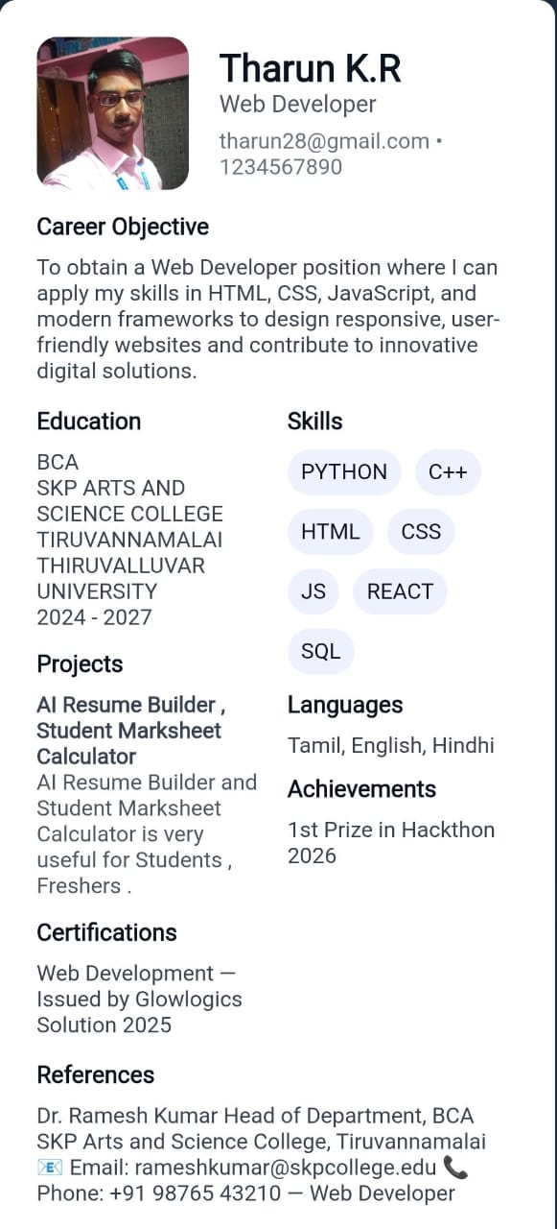
12. RESULTS AND SCREENSHOTS

Slide 15
13. CONCLUSION
The Professional AI Resume Builder project successfully demonstrates a simple and efficient way of creating resumes with a professional design. It reduces the time and effort required for resume preparation by providing a user-friendly form, live preview, and instant PDF download option. This tool is especially useful for students, freshers, and professionals who may struggle with formatting and design issues. Although the current system has limitations such as a single template and no online storage, it provides a strong foundation for future improvements like AI-powered content suggestions, multiple templates, and cloud-based saving. Overall, the project fulfills its objective of making resume building faster, easier, and more professional.

Slide 16
14. GITHUB LINK
https://github.com/periyasamy98/Periyasamy-.git

Slide 17
🙏Thank You for Your Attention 🙏
Presented By V.PERIYASAMY
Department of Computer Application
2024 – 2027 Batch

